Slide 1
Department of Behavioral Health and San Bernardino County Superintendent of Schools ROP Collaborative
Incorporating Mental Health into existing ROP courses through training and curricula development.
Educating for Careers Conference
March 2011

Slide 2
Our objectives
Brief History of Prop 63 WET funding
Overview of the Program
Sharing of Lesson Plans
Short Lesson
Q&A

Slide 3
History of Prop 63
The Mental Health Services Act (MHSA) was approved by voters in November 2004.
1% tax on income in excess of $1 million to expand mental health services.
The purpose of MHSA is to expand mental health services to previously unserved, underserved and inappropriately serves populations.
Workforce Education and Training (WET) is one of seven components of the MHSA.

Slide 4
Purpose of Workforce Education and Training
Address identified shortages in occupations, skill sets, and individuals with unique cultural and linguistic competence whom provide services in the Public Mental Health System
Increase the quality of education and training for all individuals who provide or support services in the Public Mental Health System, to include fostering leadership skills.

Slide 5
WET Plan Principles
All actions proposed in the WET Plan must meet the following principles of MHSA :
Develop and maintain a culturally competent workforce.
Include clients and family members, who are capable of providing client- and family- driven services that promote
Wellness,
Recovery, and
Resilience
Lead to measurable, values-driven outcomes.
All counties developed WET plans based on locally driven needs.

Slide 6
Key Findings of Workforce Needs Assessment
Every county conducted a workforce needs assessment to guide the local planning process. The needs discovered in San Bernardino County were:
Many pre-licensed staff
Lack of bilingual staff
Hard to fill positions
10% threshold
Loss of staff to state prison system
Not a high number of staff close to retirement
The assessment was done by surveying county and contract agency staff.

Slide 7
Programs
Programs for the WET Plan were developed in the following categories:
Workforce Staffing Support
Training and Technical Assistance
Mental Health Career Pathways Programs
Residency, Internship Programs
Financial Incentive Programs

Slide 8
Forming a partnership - Goals
DBH Goals
Meet MHSA objectives
Identify future workforce
ROP Goals
Provide teacher resources
Professional development for ROP faculty
Student awareness

Slide 9
Immersion Training and Collaboration with ROP Faculty
Goal: Network with local high schools that provide Health Training Academies
Ensure that mental health professions are well represented in the academies, and
Develop methods of introducing public behavioral health careers to high school students.

Slide 10
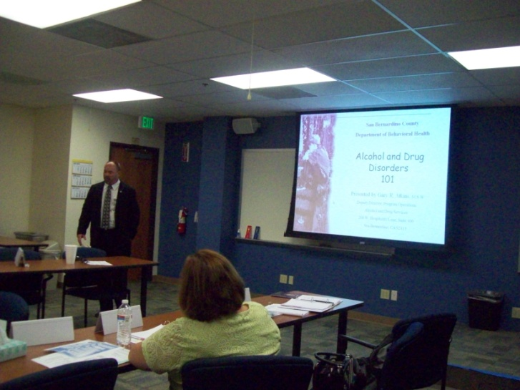
Program Goal
Introduce ROP health science teachers in order to provide students various career options in the field of behavioral health

Slide 11
Partners: Roles and Responsibilities
Department of Behavioral Health (DBH)
Develop curriculum for the immersion training
San Bernardino County Superintendent of Schools (SBCSS) ROP
Funding
Teacher recruitment
Curriculum development
Cal-HOSA
Facilitators

Slide 12
Program Design
The Professional Development for ROP health science teachers began in 2009 and included:
DBH Orientation/Training
Summer internship
Curriculum/Lesson Plan Development

Slide 13
DBH Training Overview – Year 1
5 Teachers
4-Day Training
Day 1 - DBH Orientation
Day 2 & 3 – Job-Shadowing
Day 4 – DBH Administrative Services

Slide 14
DBH Training Overview – Year 2
As a result of feedback from Year 1, the training for Year 2 was revised:
4 Teachers
3-Day training
Day 1- Orientation
Day 2 & 3 – Job-Shadowing

Slide 15
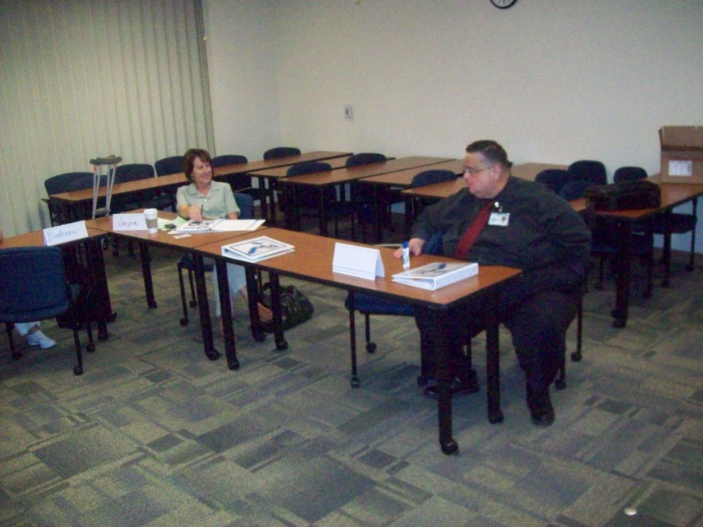
DAY 1- Orientation
Career Pathway Discussion
HIPAA and Confidentiality
Cultural Competency
Alcohol and Drug Services
Prevention and Early Intervention

Slide 16
DAYS 2 & 3 - Job-Shadowing
Community Crisis Programs
Hospital Triage Diversion Program
Consumer Clubhouse
TAY Center
Integrated Health Clinic
Outpatient Clinic

Slide 17
Participant Feedback
“… things that the team discussed with staff was the stigma that has long been associated with the mental health patient. We all agreed that this negative perception could only be corrected if educators in all sectors would begin to dispel the shroud that has veiled mental health by increasing awareness through education. The summer internship program provided a vehicle to support the efforts of the DBH and opened a whole new vista of career exploration for our high school populations. What a satisfying experience!”

Slide 18
Outcomes
Created a strong partnership
Leveraged funding
Fulfilled elements of various grant requirements for ROP Faculty Stipend funding
Provided professional development for teachers
Career Pathways
Mental Health
Network

Slide 19
Challenges
Background Check
HIPAA/Confidentiality Concerns
Under 18 volunteers/interns

Slide 20
Future expansion
Further develop the lesson plans
Summer internships for students
Professional development trainings for ROP teachers
Beginning this year
Cultural Competency
Mental Health
Alcohol and Drug Services

Slide 21
Lesson Plans – Year 1
Terminology, Behavioral Health Career Pathways, Cultural Competency, Understanding the Foundation of Behavioral Health
Looked at what students need to know and be able to do
Concepts
Skills
Standards based

Slide 22
Lesson Plans – Year 2
Two Lesson Plans
Behavioral Health Career Pathways
Understanding the Foundation of Behavioral Health

Slide 25
Sample Activity
Let’s practice a lesson…

Slide 26
Behavioral Health
Often referred to as
Mental Health or Mental Illness
Lesson Sample

Slide 27
What is behavioral health?
The term “Behavioral Health” refers to the fields of study related to assessment, diagnosis, treatment and prevention of mental illness and can include substance abuse.
“A mental illness is a psychiatric disorder that may result in a disruption of a person’s thinking, feeling and mood. It may interfere with functioning, activities of daily living and may lead to an inability to relate to others and surroundings.”
Lesson Sample

Slide 28
Control Central
Sometimes changes occur in the brain’s activity and results in short or long-term changes in these controls.
The organ in the body that controls behaviors, thoughts and feelings is the brain.
Lesson Sample

Slide 29
What Happened?
Changes in the brain can cause mental illnesses, for example:
Depression
Anxiety
Paranoia
Illnesses like these are diseases of the brain.
Lesson Sample

Slide 30
Who’s At Risk?
Everyone is at risk.
Many factors determine the likelihood of a person being affected.
Some factors:
environment
social influences
genetics
Lesson Sample

Slide 31
Get Help, It Works!
Each disease has its own treatment.
Most mental illnesses can be treated effectively with:
Psychotherapies- meeting with a counselor
Medications- a prescription given by a doctor
Lesson Sample

Slide 32
Now You Know
Without treatment the disease affects many areas of a persons life.
With treatment the person can function effectively in society.
Lesson Sample

Slide 33
Stigma
A stigma is a negative stereotype about a group of individuals.
Lesson Sample

Slide 34
Have you heard any of these?
Crazy, wacko or nuts
Morally bad
Dangerous people
Need someone to take care of them
Should be locked up in an asylum forever
Lesson Sample

Slide 35
Stigma- Is NOT reality of the illness
These preconceptions about people who have a mental illness is based on false information.
Lesson Sample

Slide 36
Stigmatizing attitudes
Cause the person with the mental illness:
Shame, guilt and loss of self-esteem
Social dependence and hopelessness
Sense of isolation
Worst of all, the stigma can cause the mentally ill person to NOT seek the very treatment that could relieve the symptoms.
Lesson Sample

Slide 37
Get over it….
A mentally ill person can not just get over it, anymore than someone who has a different type of chronic disease.
Like many other diseases it is caused by a physical problem in the body.
Lesson Sample

Slide 38
Just don’t say it!
Stigma about behavioral health cause many people to go untreated.
Don’t make reference as “ The crazy person” rather say “A person with a mental illness”
Encourage them the seek treatment
Lesson Sample

Slide 39
Activity
What do you think?
Lesson Sample

Slide 40
Resources
http://www.cimh.org/Services/MHSA/Workforce-Education-Training.aspx
Listing of WET Coordinators
List of all WET Plans

Slide 41
Contact Us
Linda Gaylor Coordinator, Curriculum and Instruction ROP, Career Training and Support Services San Bernardino County Superintendent of Schools 909-252-4559 Linda_Gaylor@sbcss.k12.ca.us
Mariann Ruffolo
County of San Bernardino Department of Behavioral Health
Administrative Manager, Workforce Education and Training
MHSA Coordinator
(909) 252-4041
mruffolo@dbh.sbcounty.gov

Slide 42
Questions?

